Slide 1
CAPSTONE PROJECT
PROJECT TITLE
Presented By:
1. K.Sinibharath ,
9513- Jayaraj Annapackiam CSI College of Engineering,
B.E Mechanical Engineering.

Slide 2
OUTLINE
Problem Statement
Proposed System/Solution
System Development Approach
Algorithm & Deployment
Result
Conclusion
Future Scope
References

Slide 3
PROBLEM STATEMENT
Background: A school has collected data on student scores for various subjects over the past academic year. The scores are stored in a dataset that includes student IDs, subject names, and corresponding scores.
Objective: The objective of this analysis is to gain insights into student performance and identify any trends or patterns in the scores across different subjects.
Tasks to be performed:
Data Cleaning
Descriptive Statistics
Subject-wise Analysis
Performance Trends
Correlation Analysis
Tools and Technologies
Constraints:
Ensure data privacy and confidentiality by anonymsing student IDs and other sensitive information.
Adhere to ethical guidelines and data protection regulations throughout the analysis process.

Slide 4
PROPOSED SOLUTION
Data Preparation:
Load the student score dataset into a pandas DataFrame.
Check for duplicate entries, missing values, and outliers.
Descriptive Statistics and Visualization:
Calculate basic descriptive statistics for each subject, such as mean, median, mode, standard deviation, and range..
Subject-wise Analysis:
Compare average scores across different subjects to identify high-performing and low-performing subjects.
Visualize the average scores using bar charts or line plots for better insights.
Performance Trends Analysis:
Identify any notable improvements or declines in student performance across subjects.
.
Grade Analysis (Optional):
If grading information is available, categorize scores into grades (e.g., A, B, C) based on predefined criteria.
Analyze grade distributions using pie charts or bar charts to understand the distribution of grades across subjects.
.

Slide 5
Key Findings and Recommendations:
Summarize key insights from the analysis, such as top-performing subjects, areas of improvement, and any significant trends or correlations.
Provide actionable recommendations for educators or administrators based on the analysis findings, such as targeted interventions for subjects with low performance or areas for curriculum enhancement.
Documentation and Reporting:
Document the analysis process, including data preprocessing steps, statistical methods used, and visualization techniques applied.
Create a detailed report or presentation that presents the analysis findings, visualizations, key insights, and recommendations in a clear and organized manner.
Code Implementation:
Write Python code using libraries such as pandas, matplotlib, seaborn, and numpy to perform the analysis tasks.
Organize the code into modular functions or scripts for readability and reusability.
Testing and Validation:
Test the code with sample data to ensure accuracy and correctness of the analysis results.
Validate the findings by comparing them with domain knowledge or consulting with subject matter experts if needed

Slide 6
SYSTEM APPROACH
Requirements Gathering:
Gather detailed requirements from stakeholders, including the types of data to be collected (e.g., student IDs, subject scores), desired analyses (e.g., average scores, trends), and any specific functionalities or visualizations required.
Data Collection and Storage:
Set up a data collection system to gather student score data from various sources such as exams, assessments, or grading systems.
Store the data in a structured format (e.g., database like MySQL or NoSQL)
Data Processing and Cleaning:
Implement data preprocessing pipelines to clean and preprocess the collected data.
Handle missing values, outliers, and inconsistencies in the data using techniques such as imputation, outlier detection, and data validation.
Data Analysis and Visualization:
Develop algorithms and scripts to perform statistical analysis on the student scores, such as calculating averages, standard deviations, and correlations.
Utilize visualization libraries (e.g., matplotlib, seaborn) to create interactive charts, graphs,
Performance Trends and Predictions:
Use time series analysis techniques to analyze performance trends over time, if historical data is available.
Implement predictive models (e.g., regression, time series forecasting) to predict future performance based on historical trends and patterns.

Slide 7
User Interface Development:
Design and develop a user-friendly interface for the student score analysis system.
Include features such as data entry forms, interactive charts, filters, and download options for reports and visualizations.
Authentication and Access Control:
Implement authentication mechanisms (e.g., login credentials, OAuth) to secure access to the system.
Define user roles and permissions to control access levels (e.g., admin, teacher, student)
Integration with Educational Systems:
Integrate the student score analysis system with existing educational systems or platforms (e.g., learning management systems, student information systems) for seamless data exchange and workflow integration.
Testing and Quality Assurance:
Conduct thorough testing (e.g., unit testing, integration testing, user acceptance testing)
Perform quality assurance checks to validate data accuracy, system performance, and user experience.
Deployment and Maintenance:
Deploy the student score analysis system to a production environment (e.g., cloud platform, on-premises server) for use by stakeholders.
Establish monitoring and maintenance procedures to monitor system performance, handle updates, and address any issues or feedback from users.
Training and Support:
Provide training sessions and documentation for users to familiarize them with the system's features and functionalities.

Slide 8
ALGORITHM & DEPLOYMENT
ALGORITHM
Data Preprocessing:
Load the student score data and perform any necessary preprocessing steps, such as handling missing values, outliers, and data normalization if required.
Descriptive Statistics:
Calculate descriptive statistics for each subject, including mean, median, mode, standard deviation, range, and quartiles.
Visualize the data using histograms, box plots, or bar charts to understand the distribution of scores.
Subject-wise Analysis:
Compare average scores across different subjects to identify high-performing and low-performing subjects.
Use statistical tests (e.g., t-test, ANOVA) to determine if there are significant differences in scores between subjects.
Performance Trends Analysis:
If historical data is available, analyze score trends over time using time series analysis techniques.
Use regression models to forecast future performance trends based on historical data patterns.
Grade Prediction (Optional):
Develop a grading model based on predefined criteria to categorize scores into grades (e.g., A, B, C).
Train the model using machine learning algorithms (e.g., decision trees, logistic regression) on historical grade data.

Slide 9
DEPLOYMENT
Infrastructure:
Choose a deployment environment based on scalability, performance, and security
Set up the necessary infrastructure components, including databases, web servers, and computational resources.
API Development:
Develop Restful APIs or web services to expose the student score analysis functionalities to client applications.
Implement API endpoints for data retrieval, analysis requests, and result delivery.
Security Measures:
Implement robust authentication and authorization mechanisms to secure access to the system and protect sensitive data.
Use encryption protocols (e.g., HTTPS, SSL/TLS) for secure data transmission over the network.
Monitoring and Logging:
Set up monitoring tools and logging mechanisms to track system performance, usage metrics, and potential issues.
Implement alerting systems for proactive monitoring and quick response to anomalies or failures.
Deployment Strategies:
Choose an appropriate deployment strategy for deploying updates and new features efficiently.
Conduct thorough testing in staging environments before deploying changes to production to minimize disruptions.
Scalability and Maintenance:
Design the system with scalability in mind to handle increasing data volumes and user traffic.
Establish regular maintenance schedules for software updates, security patches, and performance optimizations.

Slide 10
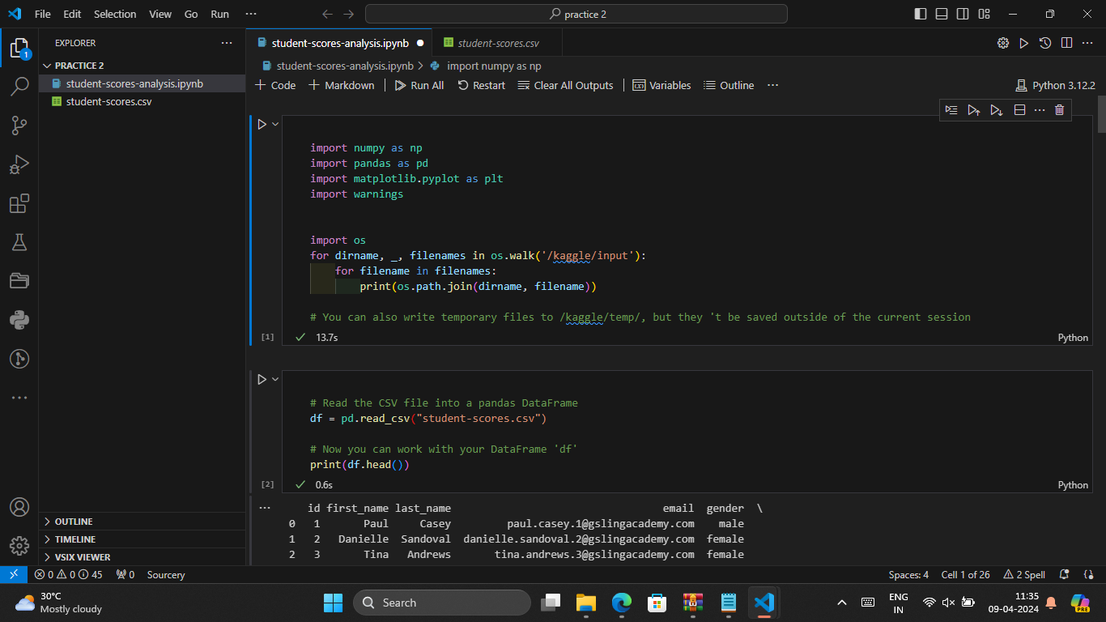
RESULT

Slide 11
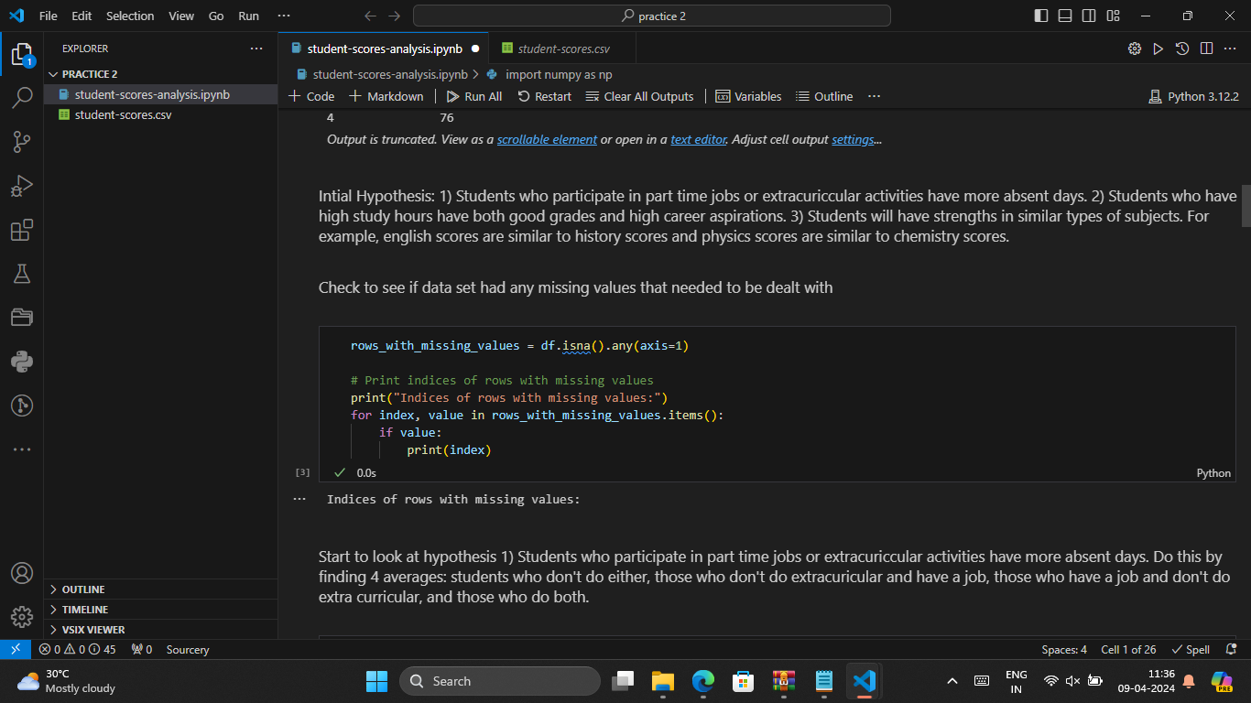

Slide 12
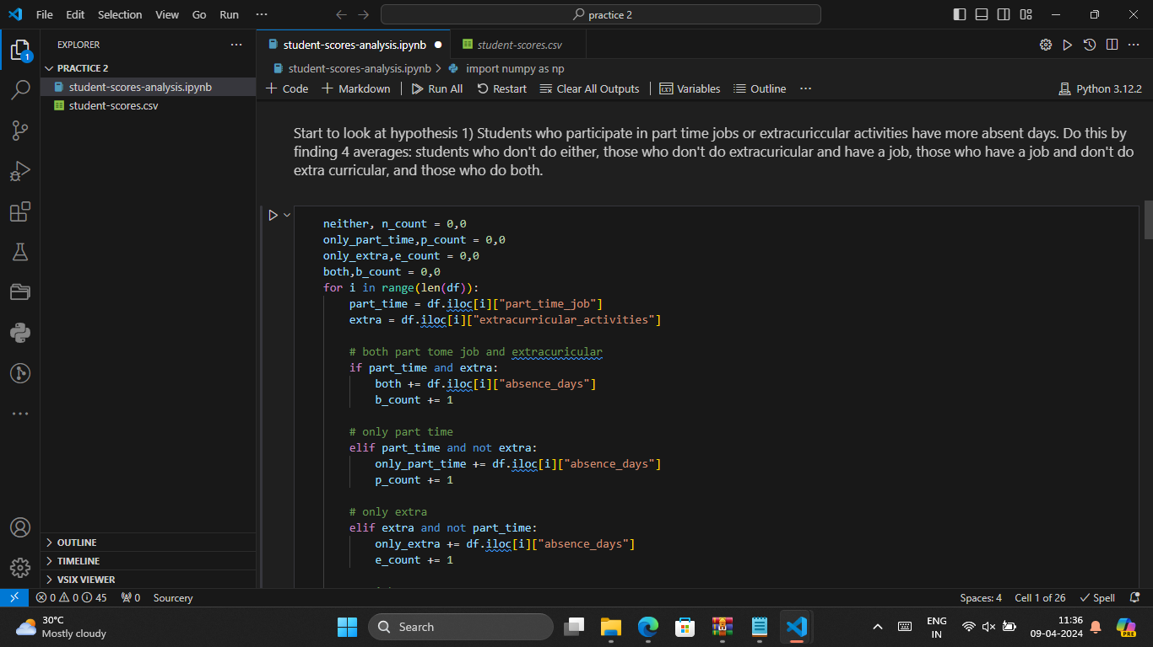

Slide 13
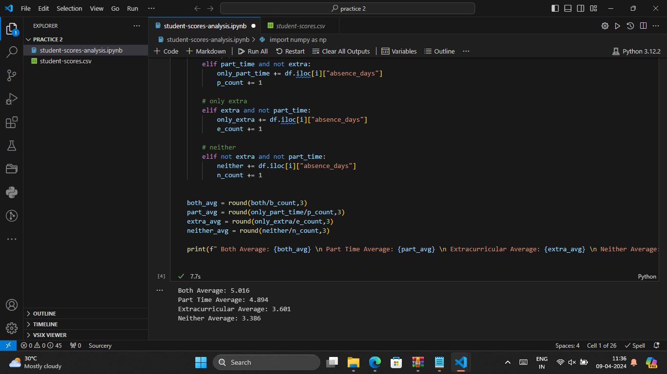

Slide 14
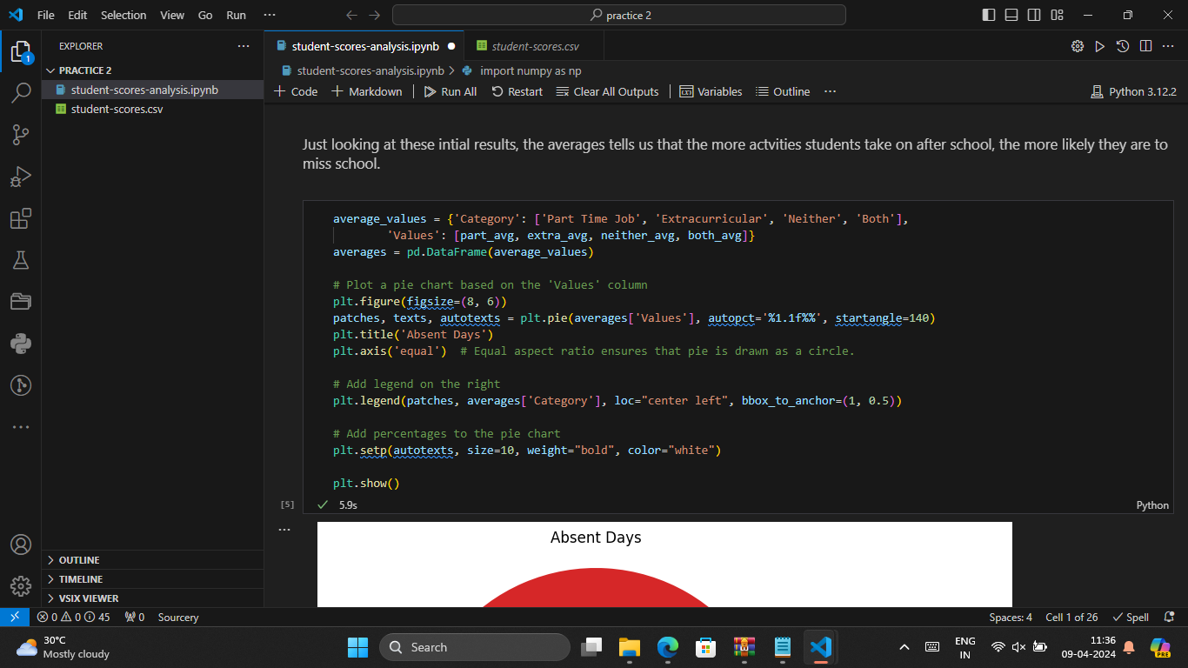

Slide 15
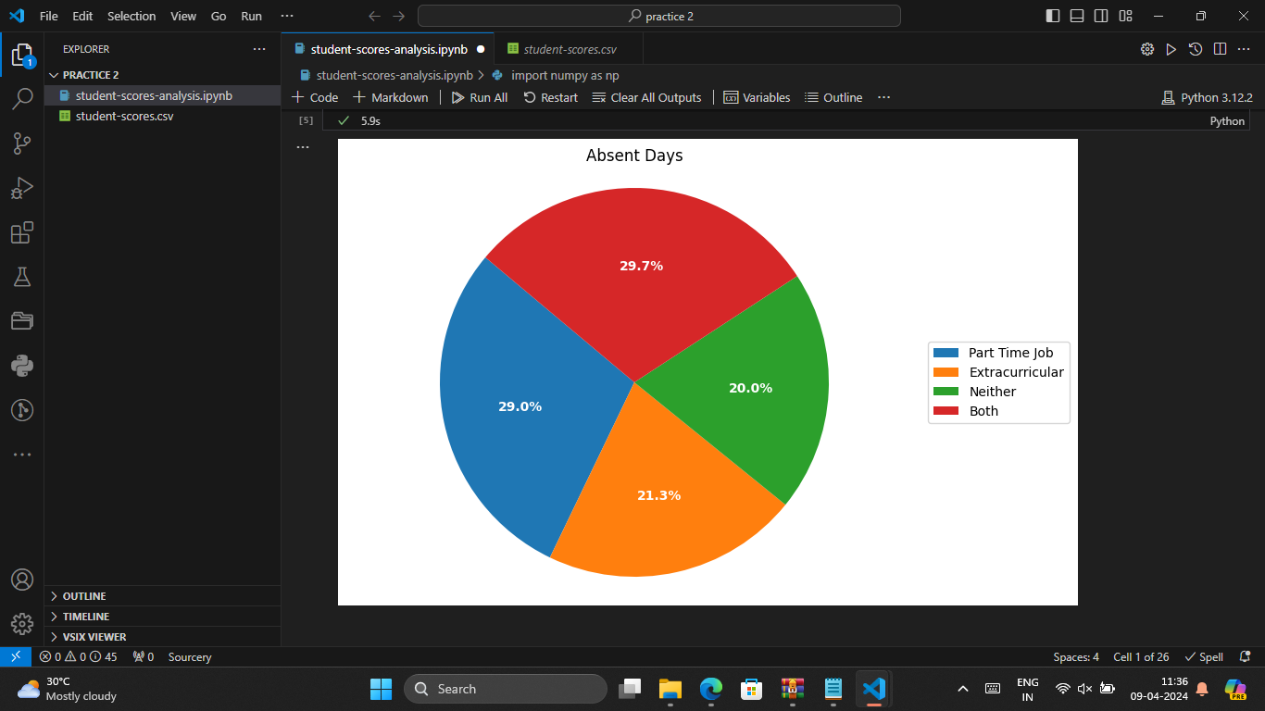

Slide 16
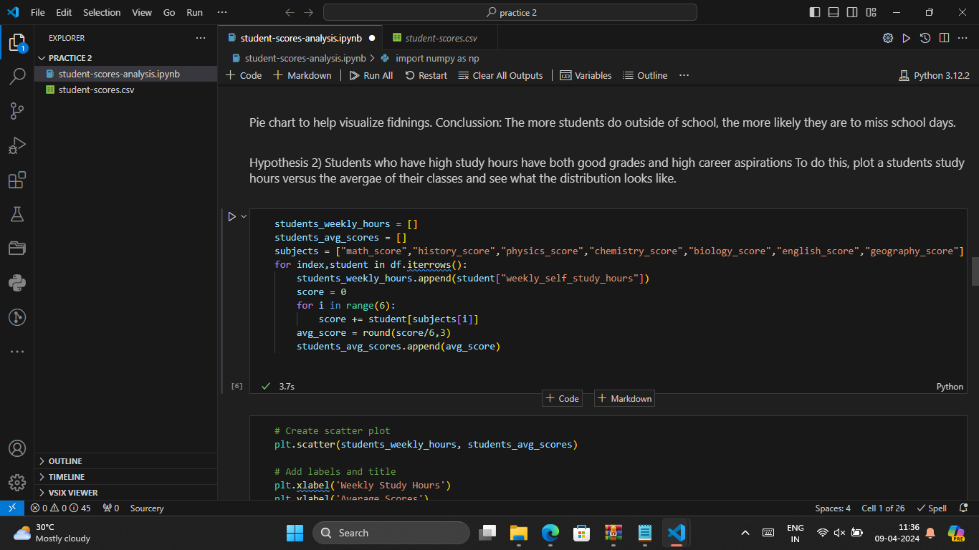

Slide 17
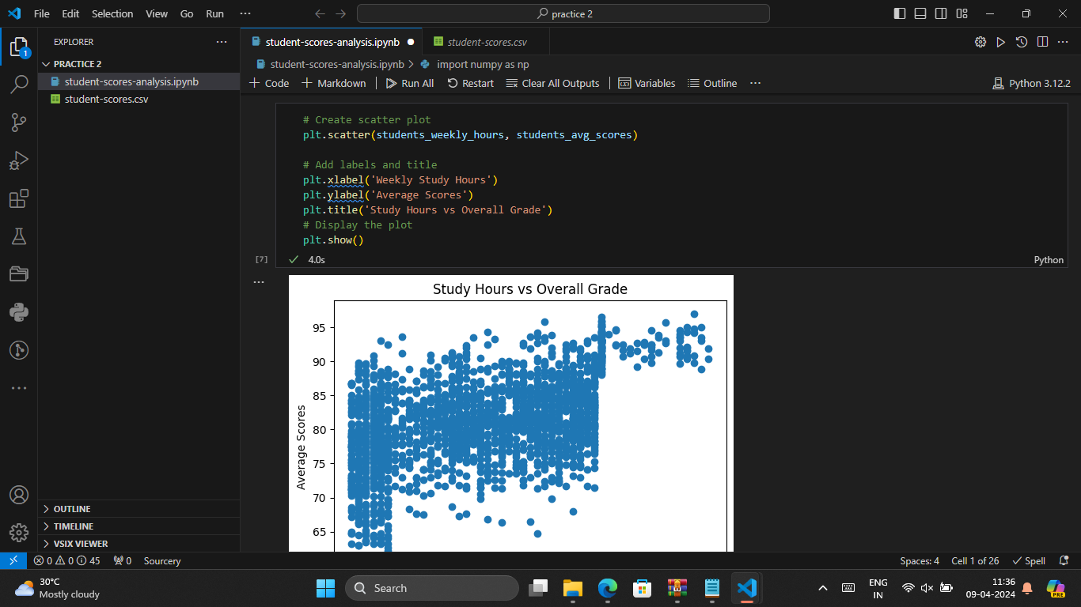

Slide 18
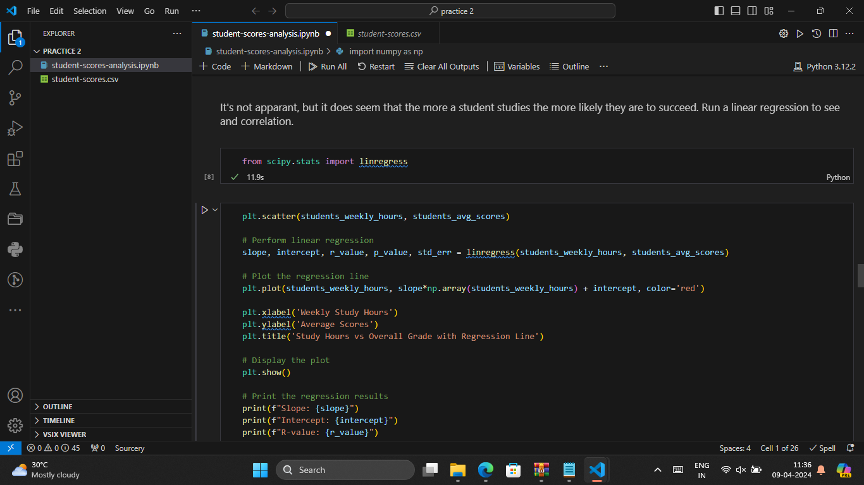

Slide 19
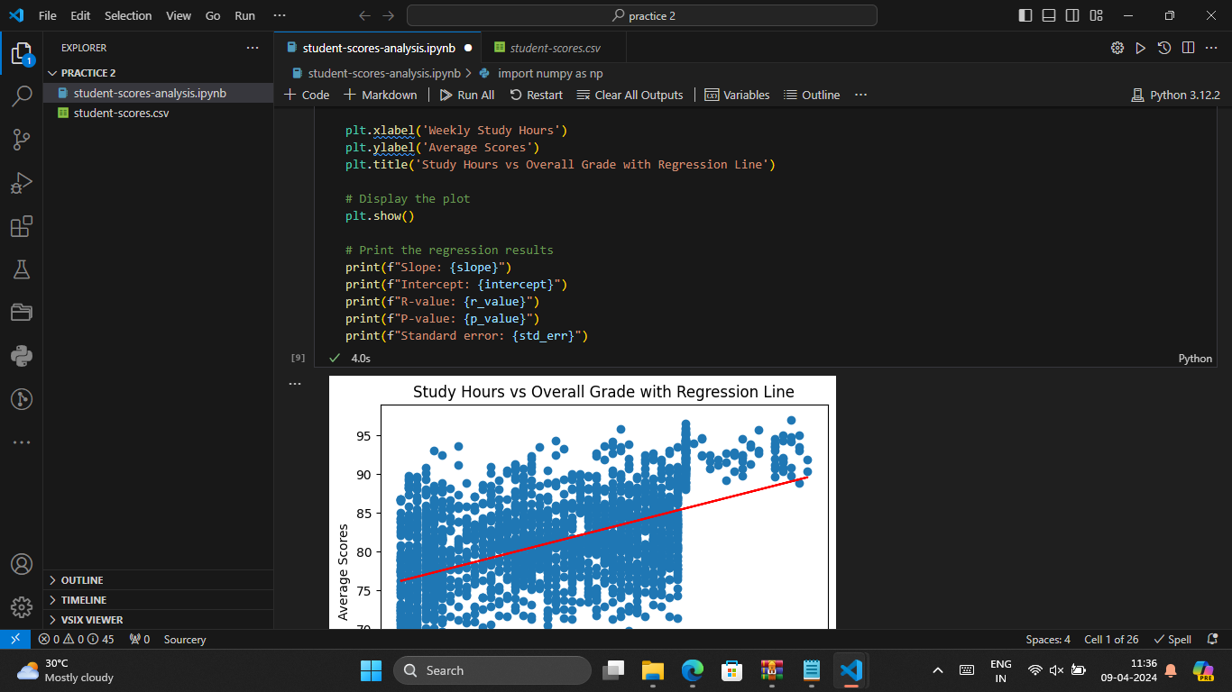

Slide 20
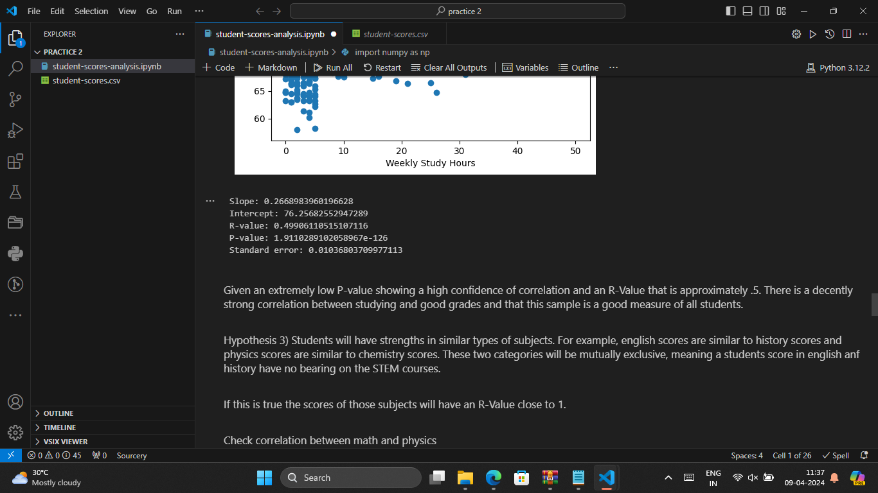

Slide 21
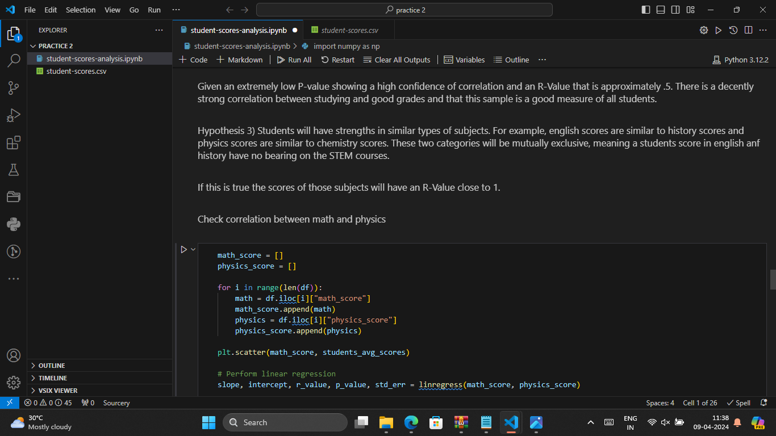

Slide 22
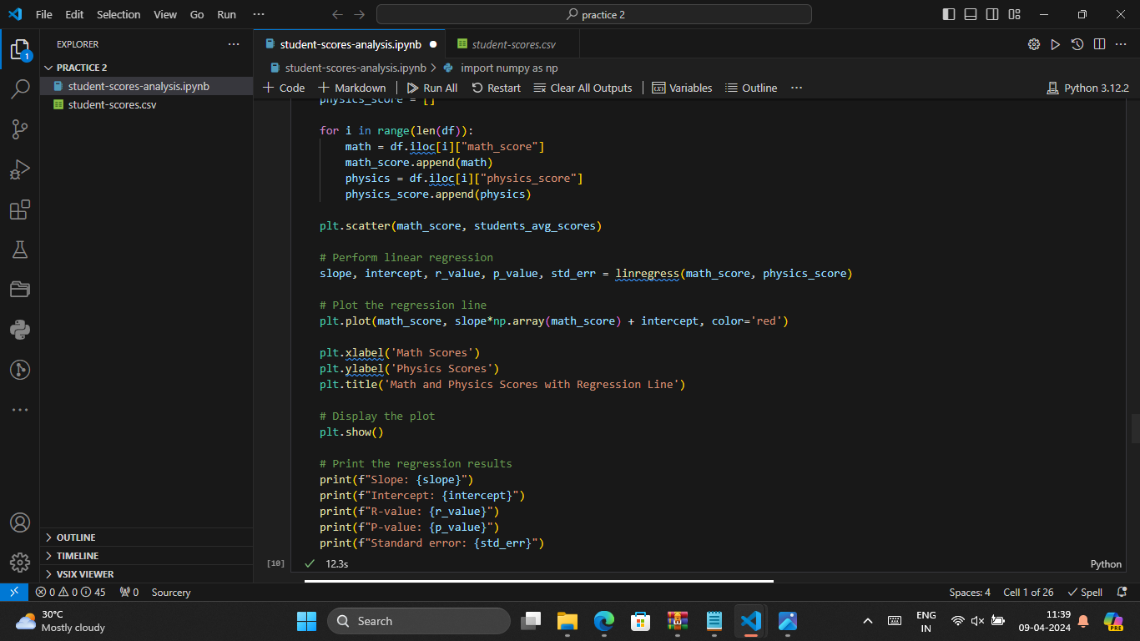

Slide 23
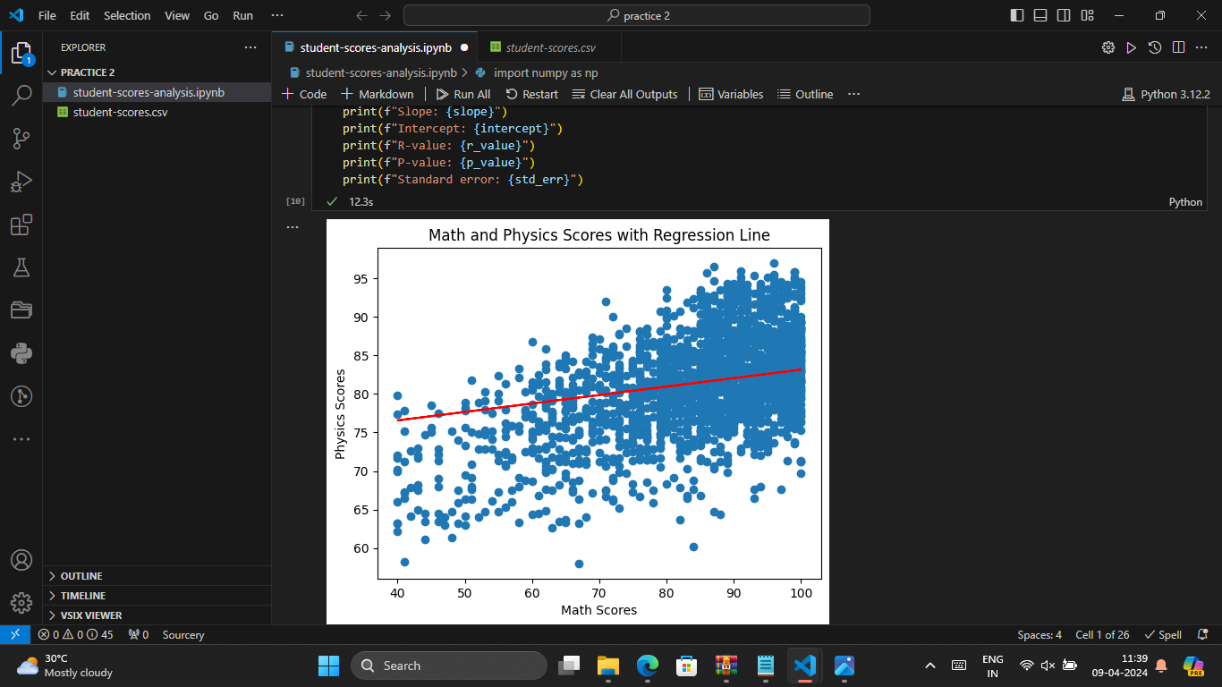

Slide 24
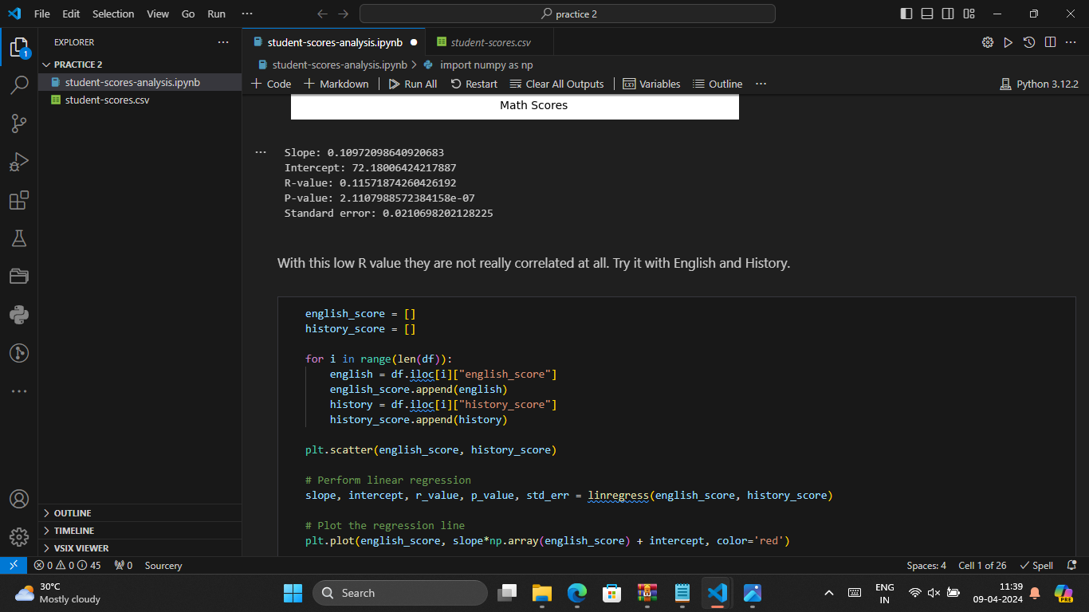

Slide 25
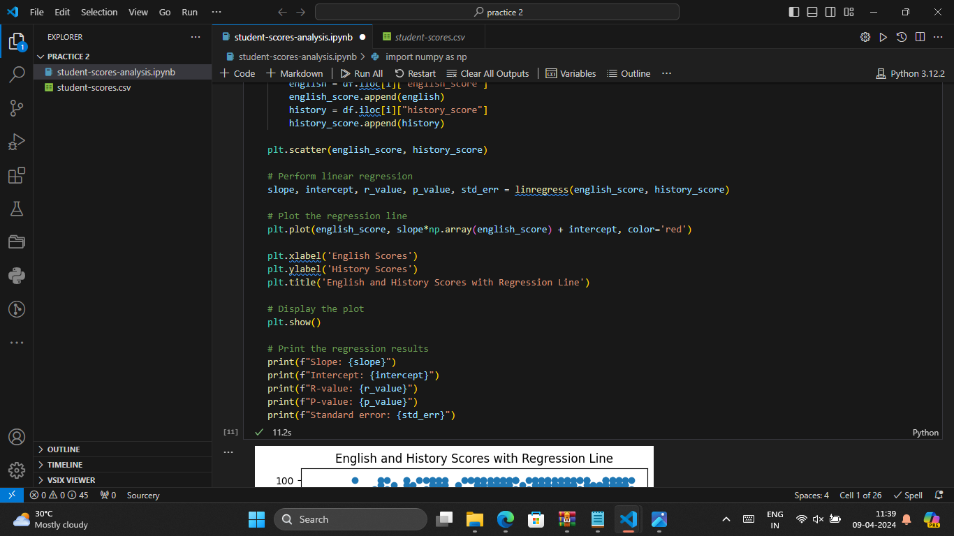

Slide 26
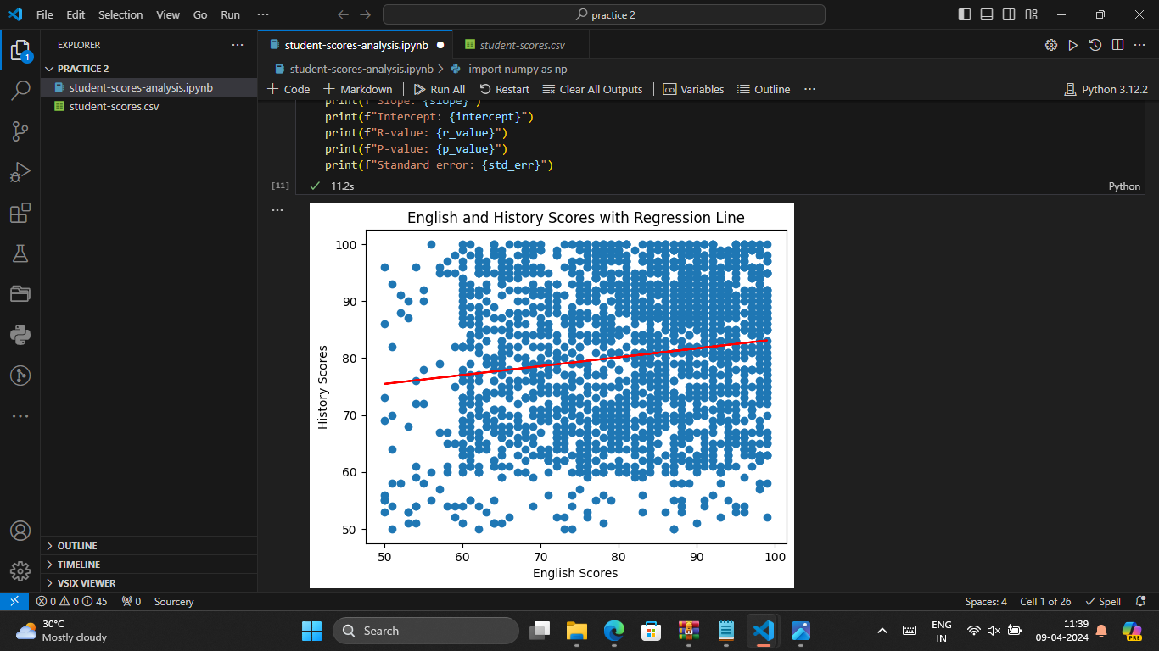

Slide 27
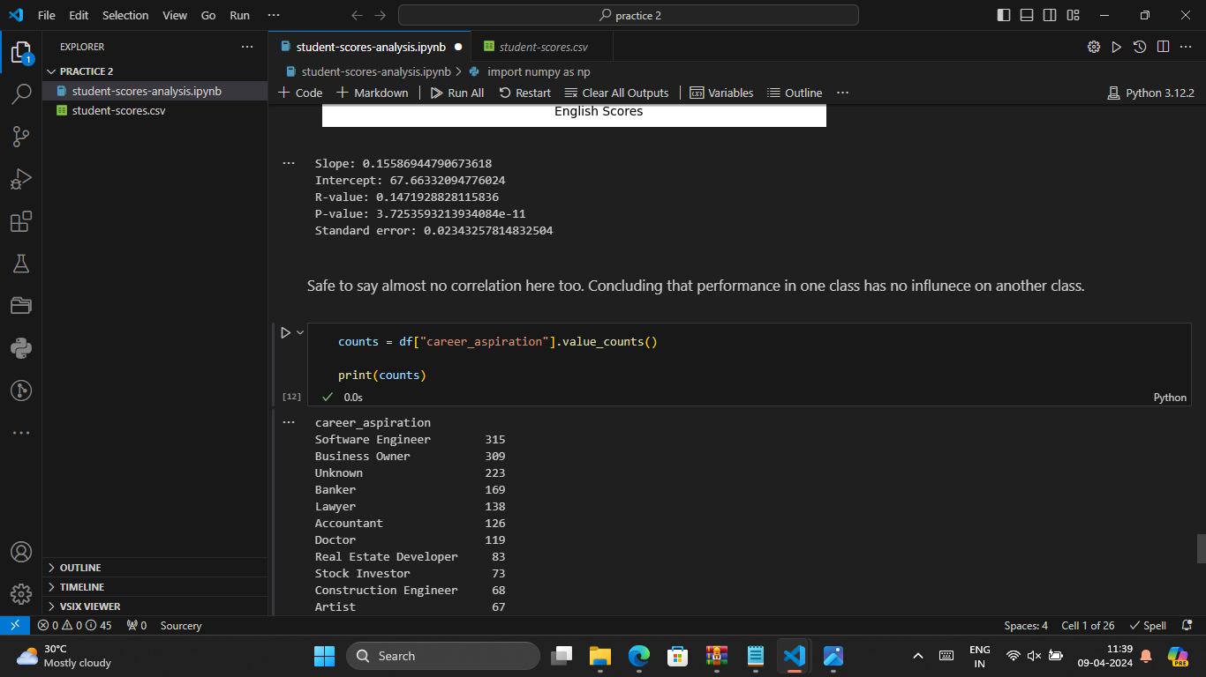

Slide 28
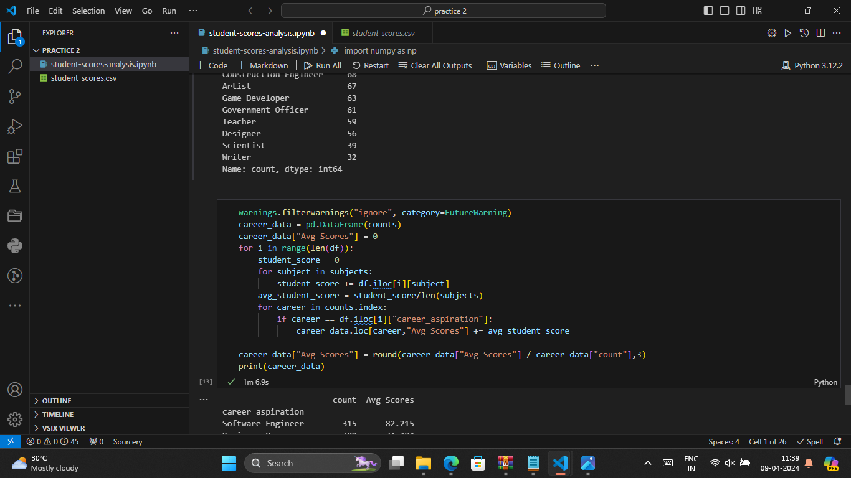

Slide 29
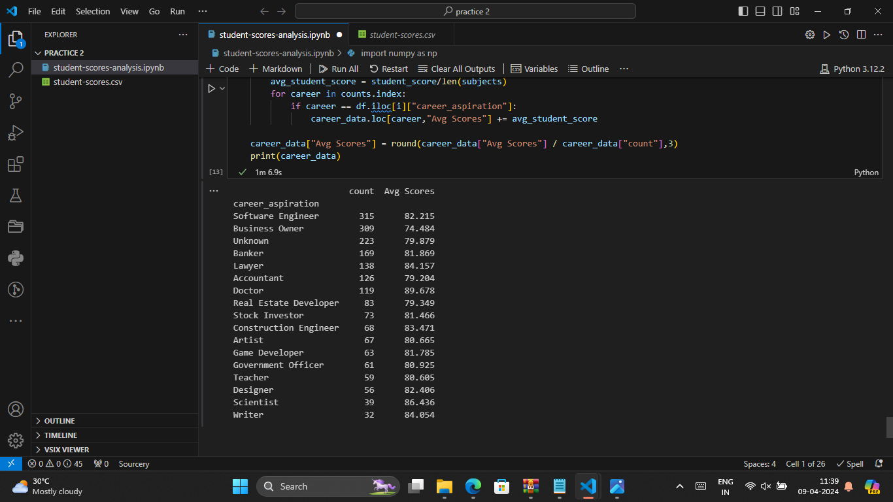

Slide 30
CONCLUSION
In conclusion, developing a comprehensive student score analysis system involves a structured approach encompassing data preprocessing, algorithm implementation, deployment considerations, and user interface development. By following these steps, educational institutions can gain valuable insights into student performance, identify areas for improvement, and make data-driven decisions to enhance teaching and learning outcomes.The algorithmic aspect involves employing statistical analysis, machine learning techniques, and data visualization to analyze student scores, identify trends, correlations, and predict future performance. This includes descriptive statistics, subject-wise analysis, performance trends analysis, correlation analysis, grade prediction (optional), and recommendation systems (optional).
Deployment considerations include infrastructure setup, API development, frontend interface design, integration with existing systems, security measures, monitoring/logging, deployment strategies, scalability, and maintenance. These aspects ensure that the student score analysis system is secure, user-friendly, scalable, and continuously monitored for performance and reliability.In conclusion, a well-designed and deployed student score analysis system empowers educators, administrators, and stakeholders with actionable insights, personalized recommendations, and data-driven strategies to support student success and academic excellence.

Slide 31
FUTURE SCOPE
The future scope of a student score analysis system encompasses several areas of development and enhancement to meet the evolving needs of educational institutions and stakeholders. Here are some potential avenues for future growth and improvement:
Advanced Analytics Techniques
Big Data and Real-time Analytics
AI-powered Decision Support Systems
Enhanced Data Visualization and Reporting
Mobile and Cloud-based Solutions
Ethical AI and Data Privacy
Integration with EdTech Ecosystem

Slide 32
REFERENCES
Books: Learning Analytics in Higher Education: Current Innovations, Future Potential, and Practical Applications" by Charles Dziuban, Anthony Picciano, and Charles Graham.
"Practical Statistics for Data Scientists: 50 Essential Concepts" by Andrew Bruce and Peter Bruce.
Research Papers and Journals: Baker, R.S., & Siemens, G. (2014). Educational Data Mining and Learning Analytics. In J.A. Larusson & B. White (Eds.), Learning Analytics: From Research to Practice (pp. 61-75). Springer.
Online Resources and Courses: Coursera: Data Science in Education Specialization (offered by Teachers College, Columbia University).
edX: Analytics for the Classroom Teacher (offered by The University of Texas at Arlington)
Conferences and Workshops : Learning Analytics and Knowledge (LAK) Conference - an annual international conference focusing on learning analytics research and practice.
Websites and Blogs: Educause Learning Initiative (ELI): Provides resources and articles on learning analytics and educational data mining.
The Learning Analytics Community Exchange (LACE): Offers insights, case studies, and resources related to learning analytics.

Slide 33
THANK YOU

